Slide 1

Attendance

Slide 2
The Math Behind Programming
By Joshua Ganschow
DSU Computer Club
11/12/24

Slide 3

Why Math Matters in Programming
Foundation of Problem Solving
Math teaches logical thinking, pattern recognition, and structured problem-solving
E.G., counting and probability help in planning algorithm efficiency and outcomes.
Optimized Algorithms
Mathematical principles guide the creation of efficient algorithms
Concepts like modular arithmetic prevent overflow, and prime factorization supports encryption.
Essential to Competitive Programming
Nearly every problem has a mathematical core, especially combinatorics and number theory

Slide 4
What is Combinatorics?
Combinatorics is the study of counting, arranging, and selecting objects in specific ways.
Helps in solving problems related to combinations, permutations, and probabilities in algorithms.

Slide 5

Key Concepts in Combinatorics: Combinations
Combinations: Arrangements where order doesn’t matter
In other words: the number of ways to pick r objects from n objects
Formula: $C\left(n,r\right)=\frac{n!}{r!\left(n−r\right)!}$
Example:
How many ways can a committee of 3 be formed from 5 people?

Slide 6
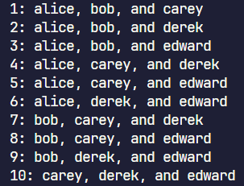
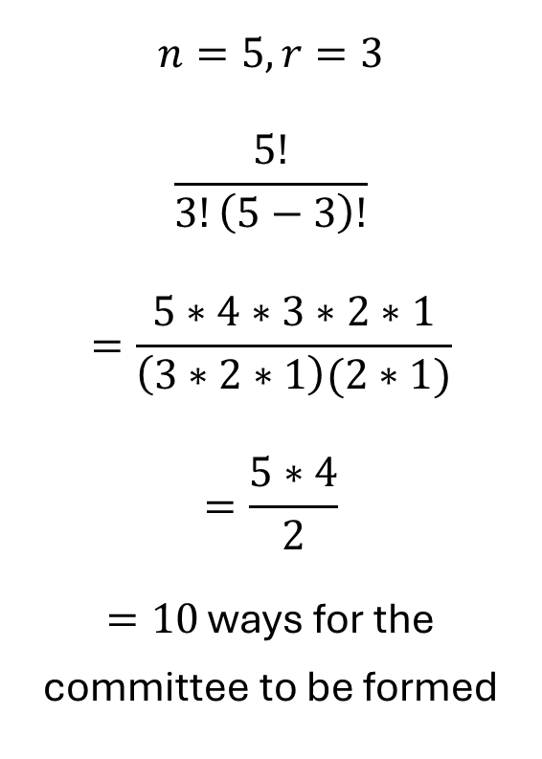
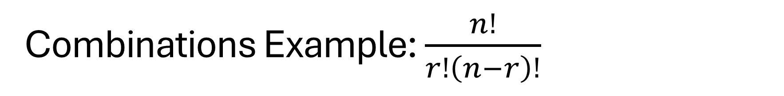
Combinations Example: $\frac{n!}{r!\left(n−r\right)!}$
Alice, Bob, Carey, Derek, and Edward
$$n=5, r=3$$
$$\frac{5!}{3!\left(5−3\right)!}$$
$$=\frac{5∗4∗3∗2∗1}{\left(3∗2∗1\right)(2∗1)}$$
$$=\frac{5∗4}{2}$$
$=10$ ways for the committee to be formed

Slide 7

Key Concepts in Combinatorics: Permutations
Permutations: Arrangements where order matters
In other words: the number of ways to permute k objects from n objects
Formula: $P\left(n,r\right)=\frac{n!}{\left(n−r\right)!}$
Example:
You have 4 books, but your shelf only has space for 2 of them. In how many different ways can you arrange 2 books from the collection of 4?
Order matters here because the bookshelf will look different depending on the order in which I place the books.

Slide 8
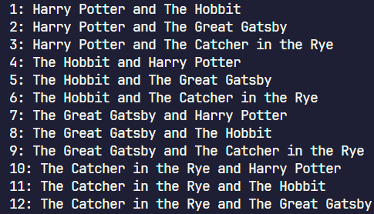


Permutations Example: $\frac{n!}{(n−r)!}$
$$n=4 r=2$$
$$\frac{4!}{\left(4−2\right)!}$$
$$=\frac{4∗3∗2∗1}{2∗1}$$
$$=4∗3$$
$$=12$$
Harry Potter, The Hobbit, Great Gatsby, Catcher in the Rye

Slide 9

Key Concepts in Combinatorics: Inclusion-Exclusion Principle
The Inclusion-Exclusion Principle provides a formula for counting elements in the union of overlapping sets by correcting for double counting.
Formula: For two sets $A$ and $B$, $\left|A∪B\right|=\left|A\right|+\left|B\right|−|A∩B|$
Example: In a group of 30 students, 18 like math, 12 like programming and 6 like both. How many students like either math or programming (not both)?
Using the above formula with $\left|A\right|=18, \left|B\right|=12$
$18+12−6=24$

Slide 10
What is Number Theory
Number theory is the study of properties and relationships of integers.
Essential in programming for understanding patterns, divisibility, prime numbers, and modular arithmetic.

Slide 11

Key Concepts: Prime Numbers and Divisibility
Prime numbers are numbers greater than 1 with no divisors (factors) other than 1 and themselves.
A number a is divisible by another number b if and only if there exists an integer x such that $bx=a$
For example:
If a is 10, b can be 1, 2, 5, or 10 because
$1∗10=10$
$2∗5=10$
$5∗2=10$
$10∗1=10$
b cannot be 3, 4, 6, 7, 8, or 9 because I am left with a remainder when I divide 10 by these numbers

Slide 12

Key Concepts: Modular Arithmetic
Deals with remainders
Taking a number a and “modding” it by another number b leaves us with the remainder of dividing a by b
For example, $a=17 b=5$
$17 \left(mod 5\right)≡2$ because 17 divided by 5 leaves us with a remainder of 2
Another example:
If I am on hour 21 of a day (9 pm) what time will it be in 13 hours?
To find this, we can add together 21 and 13 and mod that by 24 to find the remainder. This remainder is the time of day.
$21+13=34$ , $34≡10 (mod 24)$
This means it will be 10 o’clock 13 hours from 9pm!

Slide 13

Key Concepts: Prime Factorization
According to the Fundamental Theorem of Arithmetic, every positive integer greater than 1 can be uniquely represented as a product of one or more prime numbers
Example: the prime factorization of 60
$60=2^{2}∗3^{1}∗5^{1}$

Slide 14
Number Theory Applications in Programming
Greatest Common Divisor (GCD) is often used, specifically in problems that require simplifying ratios or finding coprime pairs.
Least Common Multiple (LCM) is also used often, specifically when you need to align cycles or frequencies in algorithmic problems.

Slide 15

GCD and LCM Example
Given $a=48$ and $b=12$ lets find the GCD:
GCD is the largest number that divides both and 26
The divisors of 48 are [1,2,3,4,6,12,16,24,48] and the divisors of 12 are [1,2,3,4,6,12]
This means the GCD is 12
Given $a=26$ and $b=16$ lets find the LCM
The multiples of 26 are [26, 52, 78, 104, 130, 156, 182, 208] and the multiples of 16 are [0, 16, 32, 48, 64, 80, 96, 112, 128, 160, 176, 192, 208]
This means the LCM is 208
If I wanted to find the LCM of 26, 16, and another number X, it is sufficient to find the LCM of 26 and 16 is 208 and then find the LCM of 208 and X

Slide 16
Let’s Solve Some Problems Together
https://cses.fi/problemset/task/1754/
https://projecteuler.net/problem=5
https://projecteuler.net/problem=1
https://open.kattis.com/problems/modulo

